Slide 1
Presentation Deck Liquid Lab
Matthew Lluís

Slide 2
Project Goal and Objective Statement
Goal: To establish liquid lab as the premier juice bar for urban professionals wanting to live a healthy lifestyle
Objective: Accomplish said goal by offering customized products and support to urban professionals wanting to achieve their lifestyle goals, and doing so by supplementing, not reinventing.

Slide 3
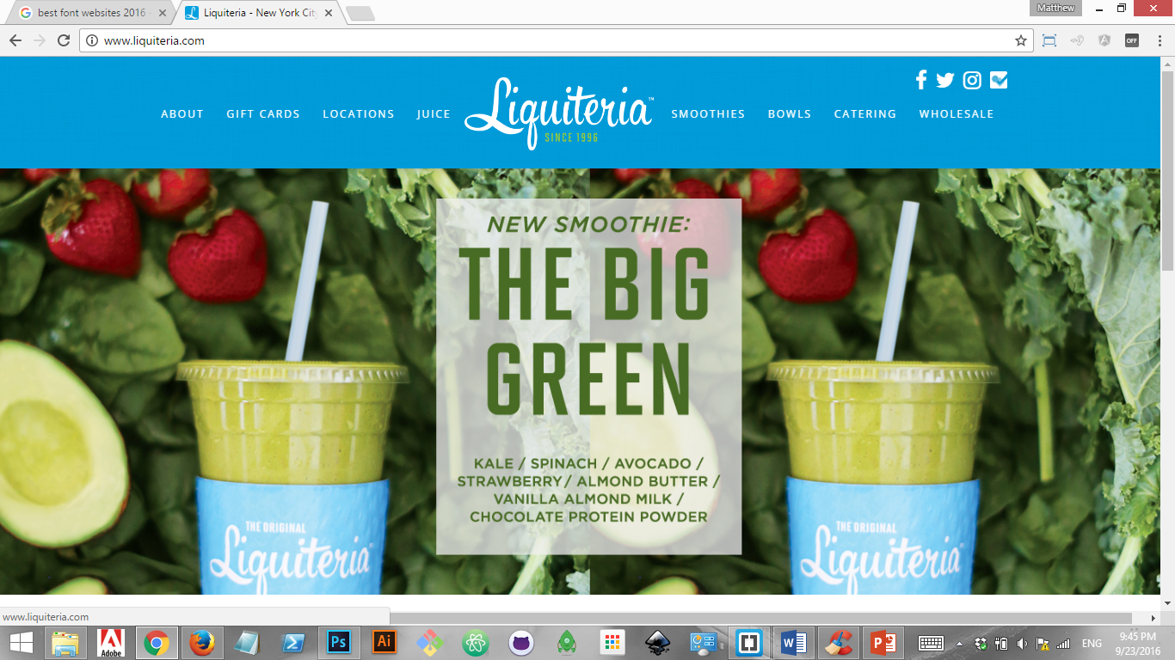
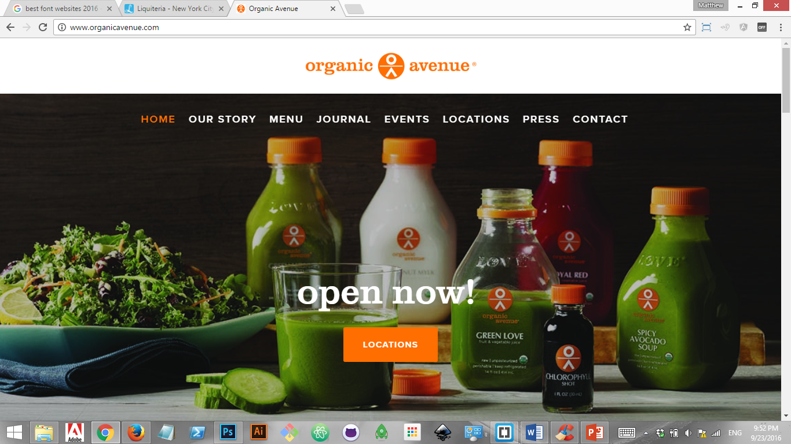
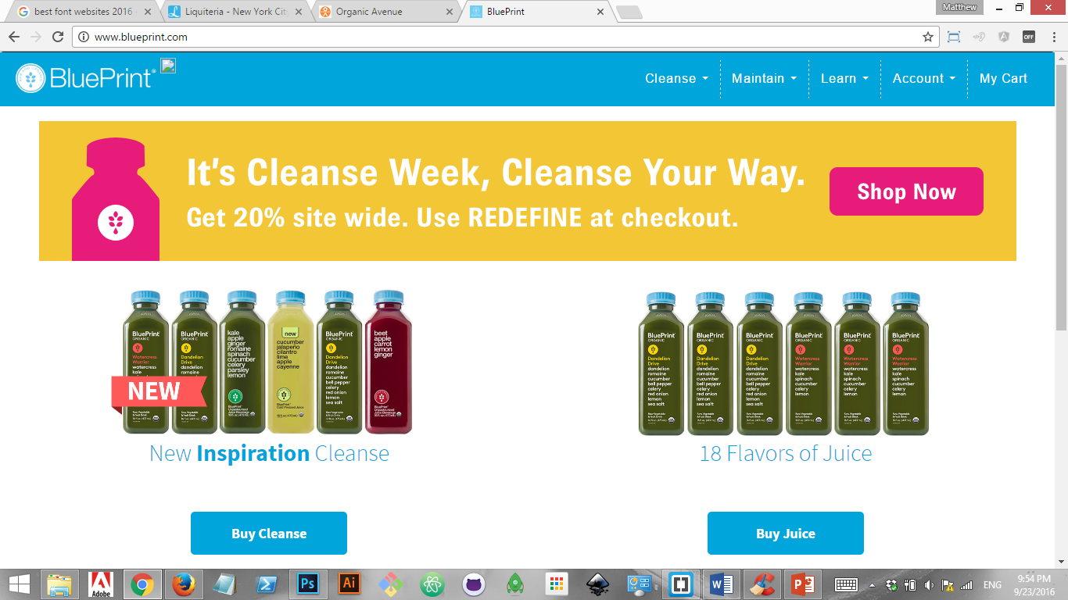
Competitive Survey
Liquiteria
website makes use of bright colors, appetizing presentation
not categorized by end-user's purpose
lacking specifics about ingredients - why is this ingredient used as opposed to another?
Organic Avenue
simple and clean website, not flashy but not dull
not very personalized
ive have no idea who they are trying to target
Blue Print Cleanse
exclusively for juice fast/cleanse dieters, so the website only targets that audience
offers more information - newsletters for example
very simple website
*Nobody is asking about information about what the client is looking for?

Slide 4
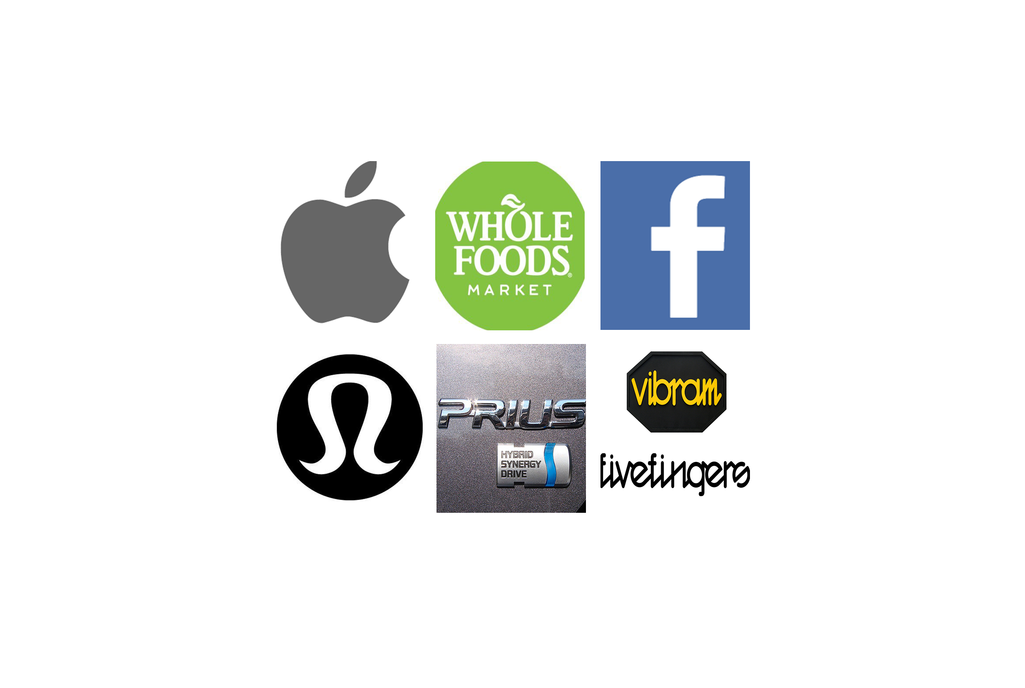
Audience Survey

Slide 5
Keywords
Positivity
Body positive
Adaptivity
Tailored
Conscious
Balanced
Tastes
Health goals
Addition
Accessible
Nutrition
Introductory
Locally Sourced
Knowledge Sharing

Slide 6

Freestyle Moodboard Keyword: Nutrition

Slide 7
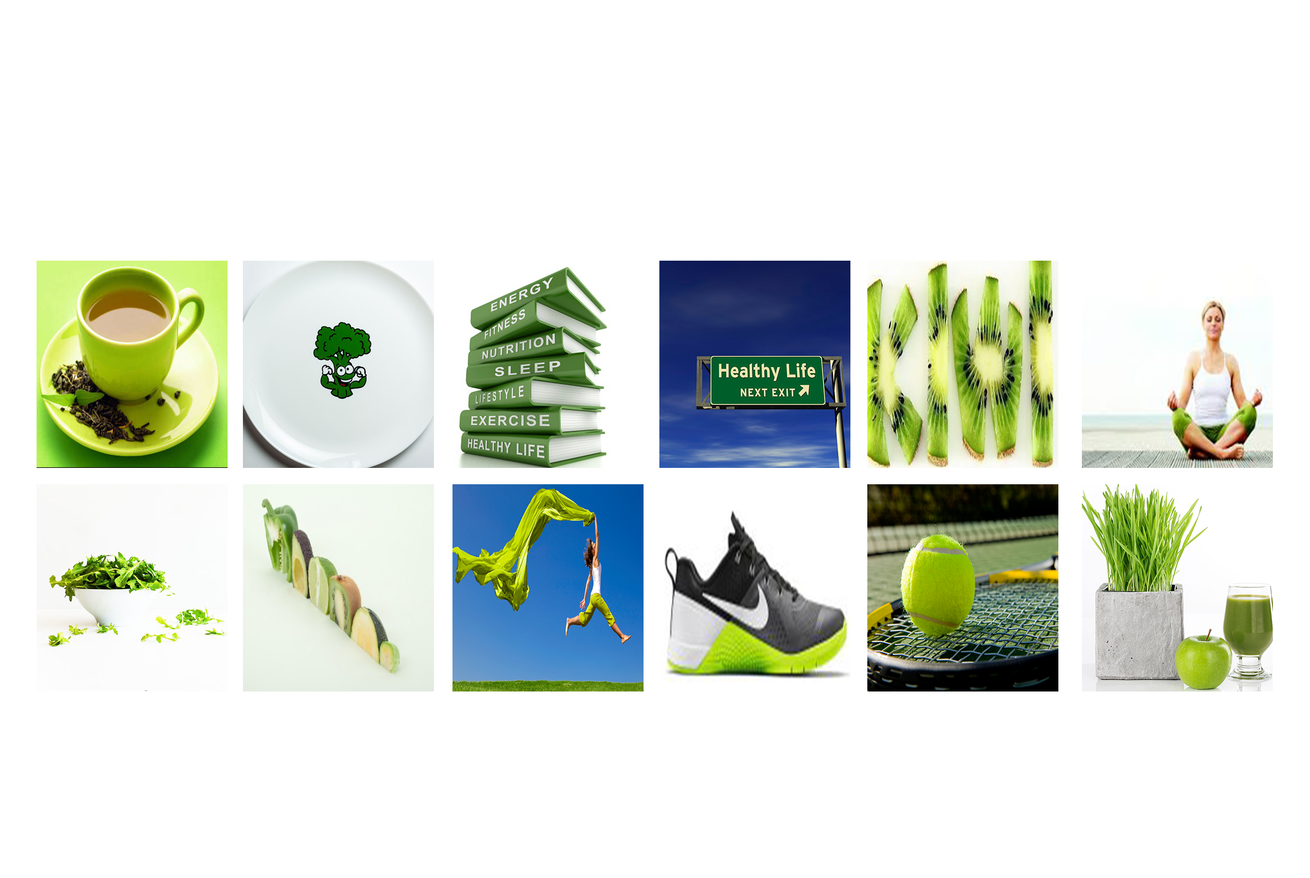
Themed Mood Board Keyword: Nutrition Style: Minimalist Color: Green

Slide 8
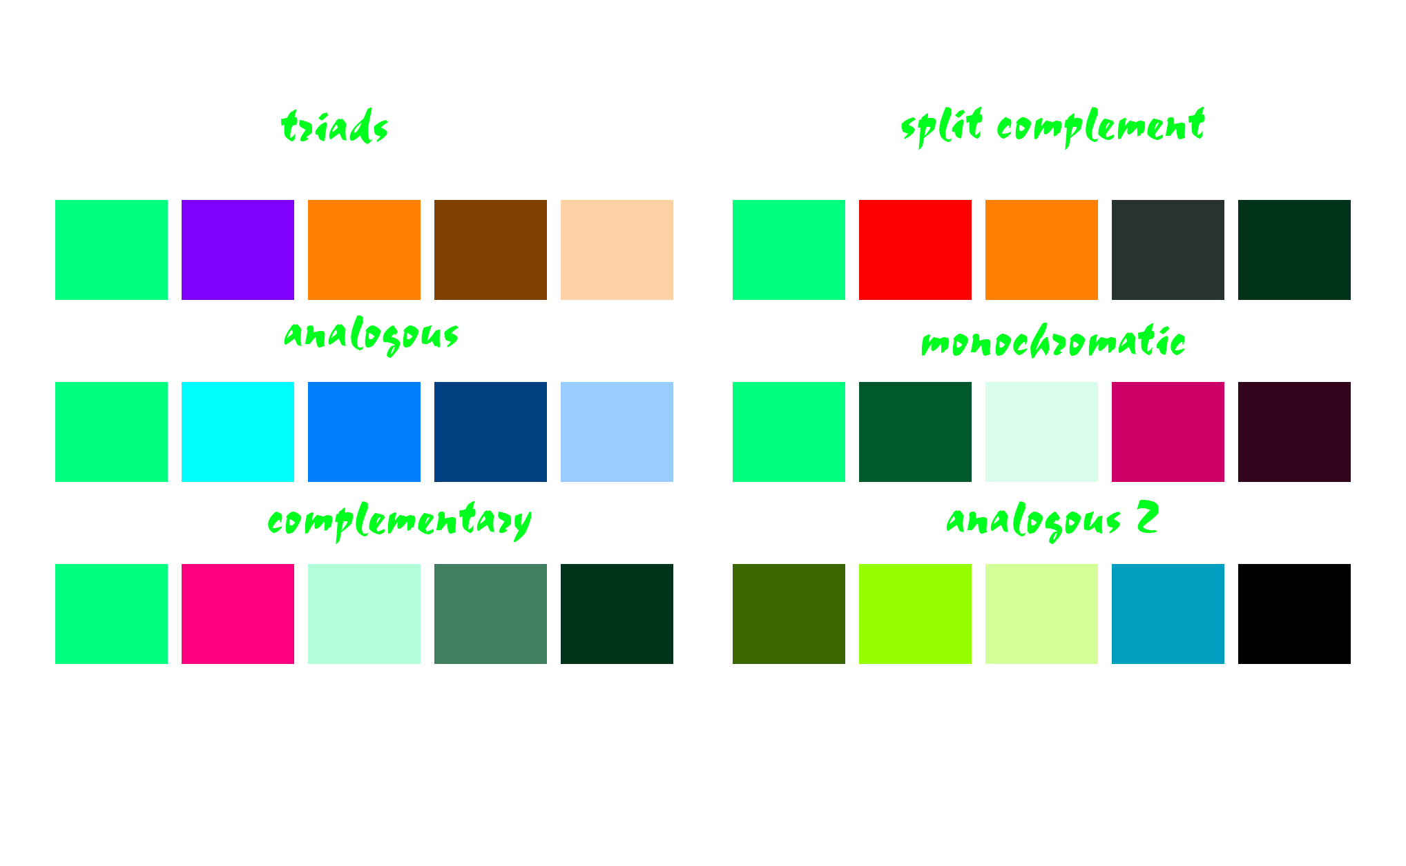
Color Scheme

Slide 9

Composition Color Scheme 1

Slide 10

Composition Color Scheme 2

